Slide 1
Wifi Locationing
Murilo Miranda

Slide 2
Agenda
Problem
Organization
Classification
Regression
Final Models

Slide 3
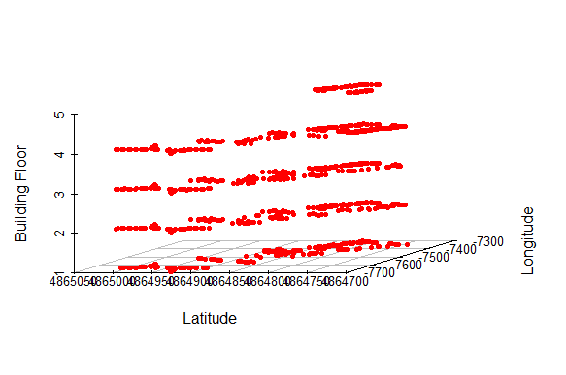
Problem
Using “wifi fingerprinting” to determine a person’s location (latitude and longitude) in indoor space.
- Classification problem:
Unique identifier (Building ID + Floor) ~ WAP’s
- Regression problem:
Longitude ~ WAP’s + Floor
Latitude ~ WAP’s + Floor

Slide 4
Organization
Pre-Process
Subsets
- data type transformation
- impute NA’s
- remove columns with zero variance
- PCA transformation
- unique identifier (Classification)
- standardization (Regression)
Memory problem:
- initial dataset size: 10% - 40%
Training/Testing sets
- 70% training set/30% testing set
- 10-fold Cross-Validation

Slide 5
Organization
Classification algorithms
Regression algorithms
k-Nearest Neighbors
knn
Decision Tree
C5.0
Random Forest
ranger and rf
Support Vector Machines
svmLinear and svmRadial
k-Nearest Neighbors
knn
Decision Tree
rpart
Random Forest
ranger and rf
Support Vector Machines
svmLinear and svmRadial
Stochastic Gradient Boosting
gbm

Slide 6
Classification
 | knn | C5.0 | ranger | rf | svmLinear | svmRadial
Accuracy | 0.931 | 0.938 | 0.961 | 0.958 | 0.936 | 0.909
Kappa | 0.921 | 0.929 | 0.956 | 0.952 | 0.927 | 0.895
Time (sec) | 35.22 | 512.06 | 389.30 | 364.67 | 21.30 | 132.00

Slide 7
regression
 | knn | rpart | ranger | rf | svmLinear | svmRadial | gbm
RMSE | 14.00 | 52.04 | 13.47 | 13.13 | 34.25 | 42.45 | 15.28
Rsquared | 0.987 | 0.824 | 0.988 | 0.989 | 0.924 | 0.888 | 0.985
MAE | 6.708 | 43.163 | 6.390 | 5.933 | 23.539 | 23.228 | 9.582
Time (sec) | 38.24 | 16.48 | 398.94 | 1885.44 | 216.67 | 55.22 | 83.22
Longitude
 | knn | rpart | ranger | rf | svmLinear | svmRadial | gbm
RMSE | 10.65 | 27.13 | 8.78 | - | 19.83 | 24.84 | 11.42
Rsquared | 0.973 | 0.826 | 0.982 | - | 0.909 | 0.861 | 0.969
MAE | 5.805 | 21.751 | 5.192 | - | 14.304 | 14.350 | 7.960
Time (sec) | 42.41 | 16.08 | 406.76 | - | 212.99 | 66.28 | 84.06
Latitude

Slide 8
Final models
CLASSIFICATION: SVM-Linear
REGRESSION: knn
 | Accuracy | Kappa
Model | 0.984 | 0.982
Validation | 0.868 | 0.852
Model | RMSE | Rsquared | MAE
Longitude | 5.14 | 0.998 | 1.829
Latitude | 4.26 | 0.996 | 1.841
Hypotenuse | 4.26 | 0.996 | 1.841
Validation | RMSE | Rsquared | MAE
Longitude | 21.37 | 0.969 | 8.91
Latitude | 15.30 | 0.952 | 7.99
Hypotenuse | 15.31 | 0.953 | 7.99

